Slide 1
Secure APIs design and implementation using Eve and PrivacyIDEA
Paolo Stivanin - 845883
SOA Security

Slide 2
What is ReST
ReST stands for Representional State Transfer. It is a software design pattern typically used for web applications. The basic idea of ReST is treating objects on the server-side (as in rows in a database table) as resources which can be created, modified or destroyed.
HTTP Verb | Collection (/vms) | Resource (/vms/<id>)
GET | list all vms | list single vm
POST | create a vm | 405 (not supported)
PUT | 405 (not supported) | entirely update a vm
PATCH | 405 (not supported) | update only one or more fields of a vm
DELETE | 405 (not supported) | delete a vm

Slide 3
Software
Python (version 3.3.5)
Eve Framework (version 0.5-dev)
PrivacyIDEA (version 1.5-dev7)
MongoDB (version 2.6.5)
MySQL (version 5.5.40)
PolPyC (self developed python web client)

Slide 4
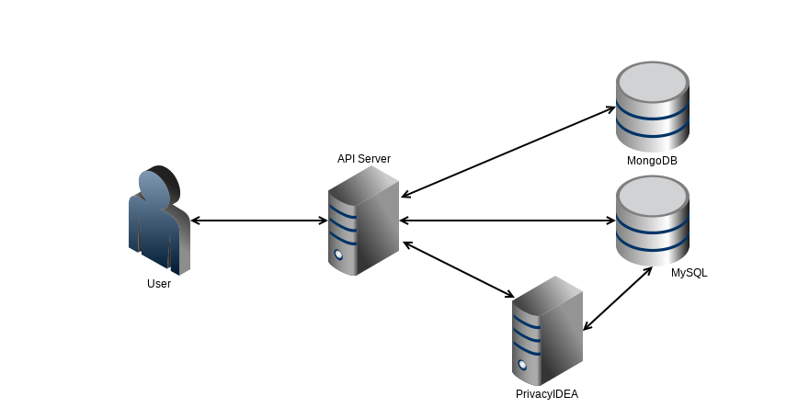
Workflow (1)

Slide 5
Workflow (2)
The user do a POST request to the /accounts endpoint on the API Server (AP) specifying his/her username and password;
The AS answers with a token which is valid for 1 day;
The user enroll a new OTP token using the selfservice endpoint on the PrivacyIDEA server (PS);
Using the token the user can now authenticate each request against the AS;
The token must be updated every 24 hours by signin in to the PrivacyIDEA server using the user’s password and an OTP value (generated, for example, using FreeOTP)

Slide 6
Authentication and authorization
Premise: every connection must be done over TLS (it’s better to avoid SSL)
The user’s password is hashed using bcrypt with a random salt and then stored inside the database;
The token is randomly generated using /dev/urandom
Before sending every request the HMAC of the request’s body is computed and added as a header value;
User Restricted Resource Access (U.R.R.A.): each user can only access his/her resources;
To generate a new token the user must sign in to the PrivacyIDEA server using his/her password and an OTP value;

Slide 7
check_token_validity
def check_token_validity(d1):
d2 = datetime.now(timezone.utc)
s = (d2-d1).seconds + (d2-d1).days * 86400
m = round(s/60)
if m >= 1440:
return False

Slide 8
check_otp_auth
def check_otp_auth(user, passwd, otp):
req_url = "https://localhost:5001/validate/check?user=" + user + "&pass=" + passwd + otp
r = requests.get(req_url, verify=False)
parse = r.json()
res = parse['result']['value']
if res == False:
return False
else:
return True

Slide 9
check_HMAC
orig_hmac = request.headers.get('Content-HMAC')
tmp_tk = request.headers.get('Authorization')
b64_tk = tmp_tk.split(' ')[1]
real_tk = base64.b64decode(b64_tk).decode()
real_tk = real_tk.split(":")[0]
secret_key = get_seckey_from_token(real_tk)
key = bytes(secret_key, encoding='utf-8')
msg = request.data
if len(msg) == 0:
msg = '{}'.encode()
hm = hmac.new(key, msg, sha1).digest()
computed_hmac = base64.b64encode(hm).decode()
if orig_hmac != computed_hmac:
abort(401, description="Wrong HMAC")

Slide 10
Alternative authentication methods
In addition to the token-based authentication Eve provides the following authentication methods:
None → Authorization: Basic user:base64(pwd)
Bcrypt → Authorization: Basic user:bcrypt(pwd)
SHA1 → Authorization: Basic user:sha1(pwd)
HMAC → Authorization: user:HMAC(body)

Slide 11
Example Requests
./polpyc <endpoint> <method> <token> <JSON> <secret_key> <etag>
Create a new user:
./polpyc accounts post none '{"username":"","password":""}' none none
Insert a new VM:
./polpyc vms post $token '{"name":"myvm","os":"gentoo","resources":{"vCPU":"4","RAM":"2048","Disk":"1000"},"actions":["start"]}' $sec_key none
Update user’s token:
./polpyc accounts/object_id patch $token '{"username":"","password":"","otp":""}' $sec_key $etag

